Slide 1
Alfresco Engineering
David Webster
Staff Software Engineer

Slide 2

The code doesn’t write itself

Slide 3
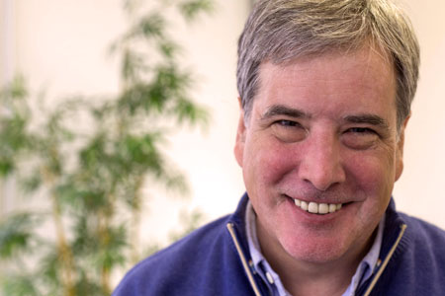
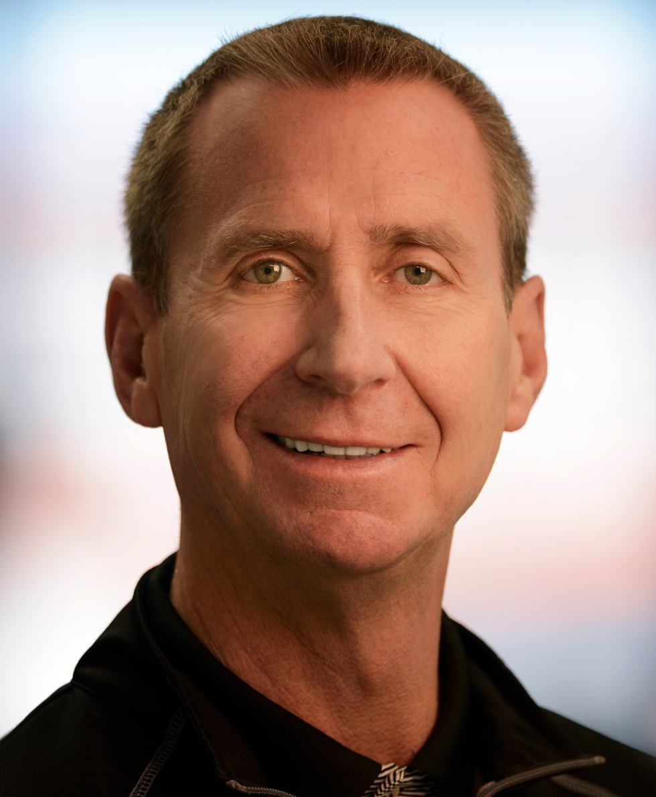
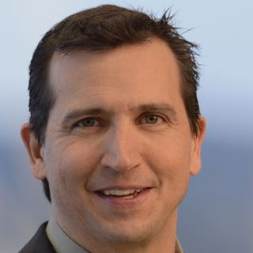
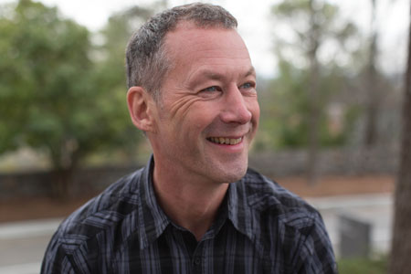
Decision Makers
John Newton
Chairman & CTO
Doug Dennerline
CEO
Thomas DeMeo
VP Product Management
Paul Holmes Higgins
General Manager, Activiti

Slide 4
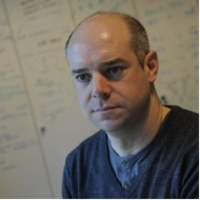
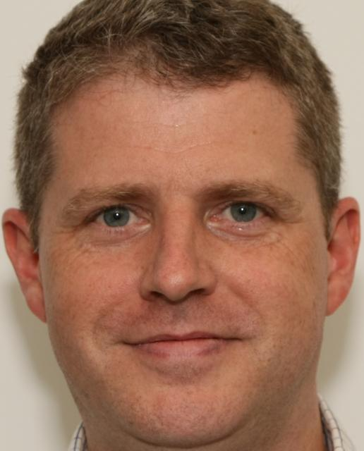
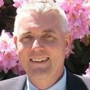
Product Development
Mark Heath
VP Product Development
Brian Remmington
VP Engineering
Greg Melan
System Architect

Slide 5
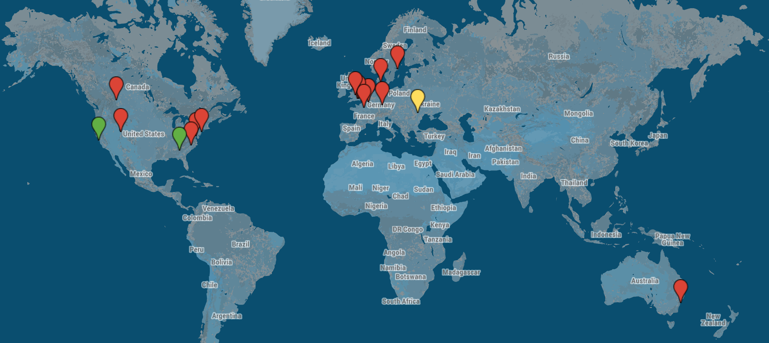
Follow The Sun Development

Slide 6

Records Management

Slide 7
3-in-a-box

Slide 8
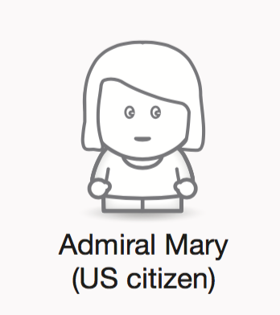
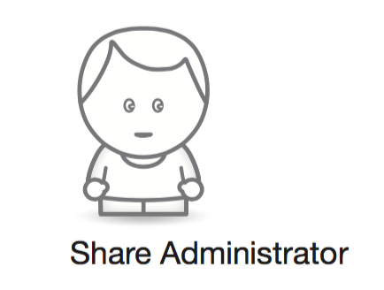

Flows and Wireframes

Slide 9
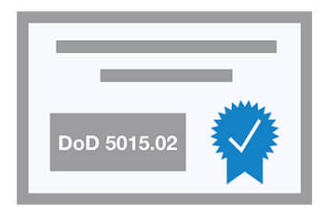
Validation
When: Early & frequent
Who: Existing customers & prospects

Slide 10

Engineers: Task Breakdown

Slide 11
Building the Backlog
Maintenance
(bug fixes)
New features
Innovation
Backlog

Slide 12

Bugs

Slide 13

Development Scrum Teams

Slide 14
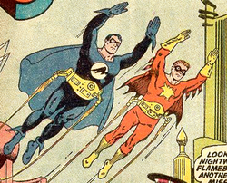
Nightwing and Flamebird

Slide 15
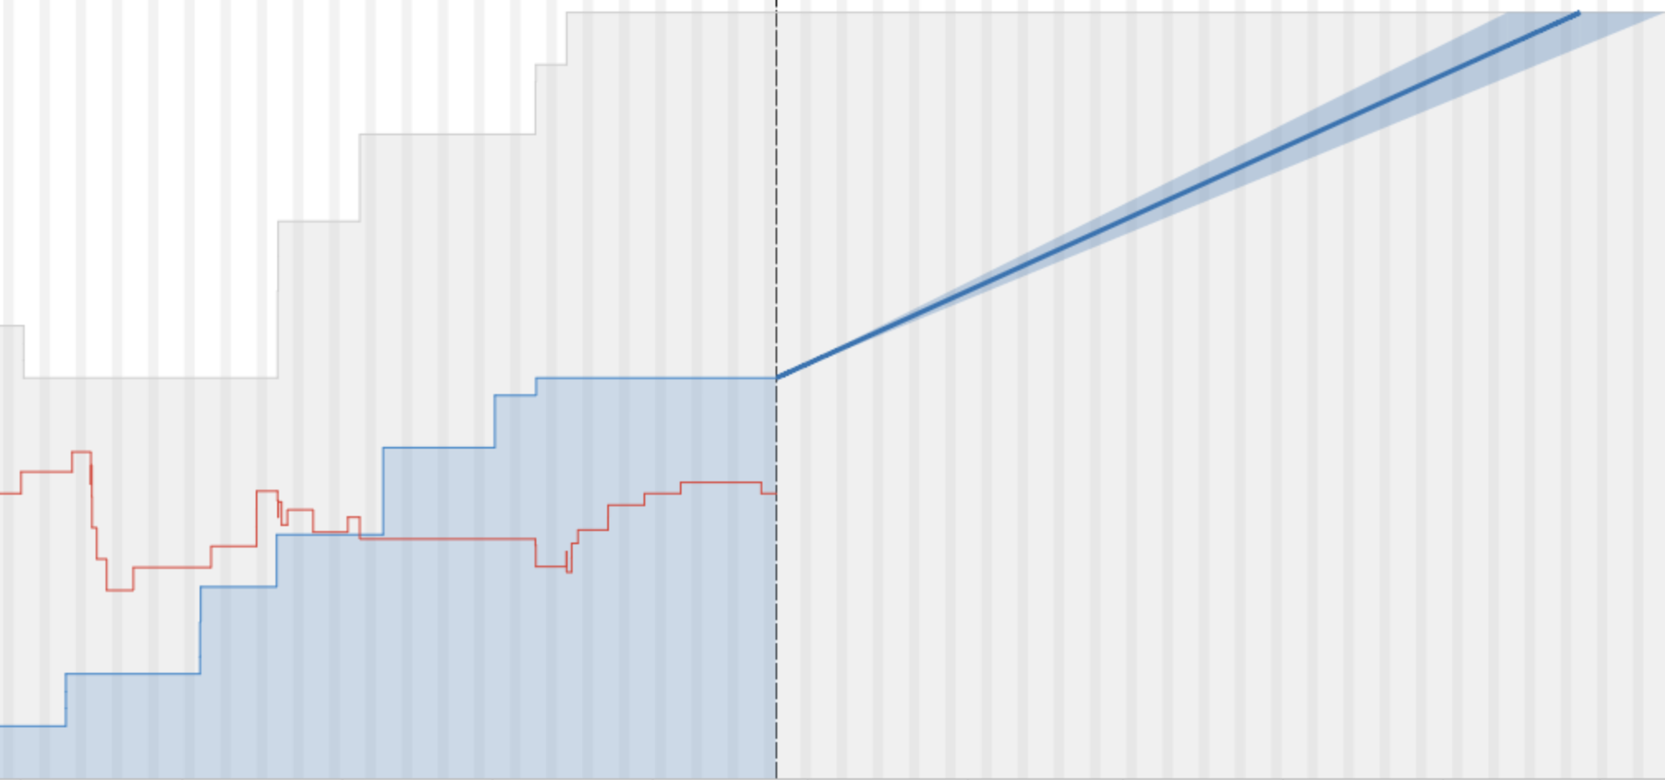
Release Velocity

Slide 16

Git

Slide 17







Where/When/How

Slide 18
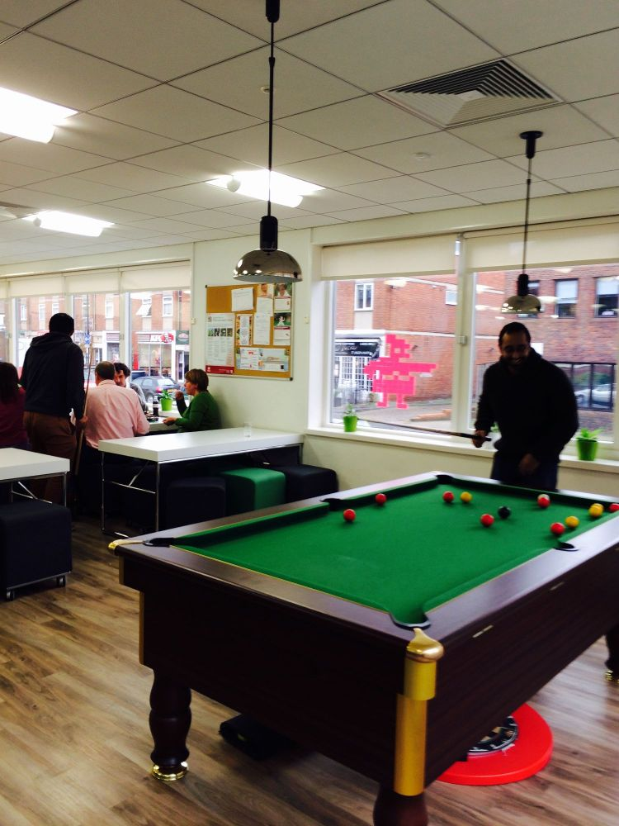
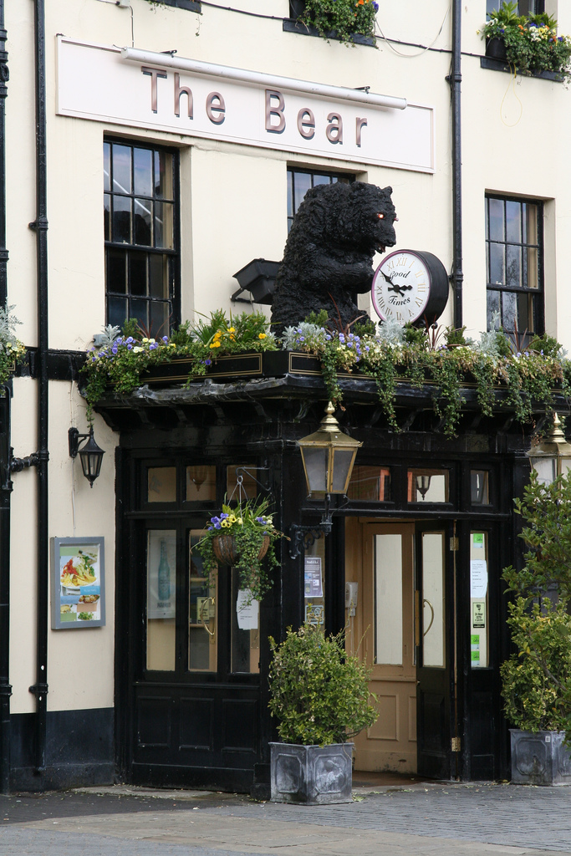
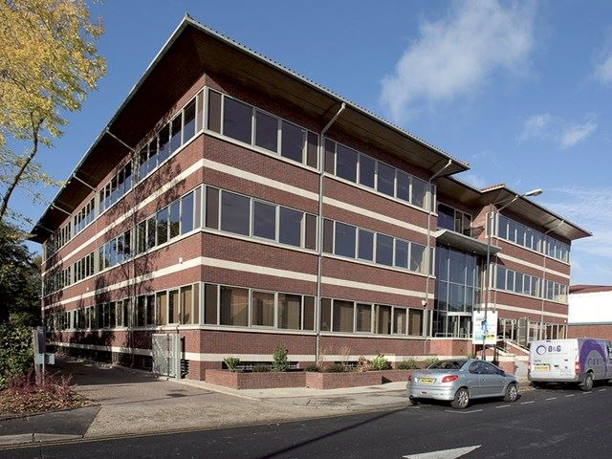

Maidenhead Office

Slide 19

Work in Progress

Slide 20

Points to Remember
Early idea validation
Engineers own story breakdown
Shared ownership (process, code, tests, bugs)
No surprises on backlog
Innovation, maintenance & features all prioritised on backlog

Slide 21
Points to remember
Early idea validation
Engineers own story breakdown
Shared ownership (process, code, tests, bugs)
No surprises on backlog
Innovation, maintenance & features all prioritised on backlog

Slide 22

Alfresco Engineering
David Webster
Staff Software Engineer

